Slide 1

Introduction to Probabilistic Machine Learning
Ralf Herbrich
Bayesian Regression

Slide 2
Overview
Bayesian Linear Regression
Bayesian Linear Regression via Message Passing
Normal Distribution Revisited
Posterior and Predictive Distribution
Fast Bayesian Linear Regression
Bayesian Linear Regression via Linear Algebra

Slide 3
Overview
Bayesian Linear Regression
Bayesian Linear Regression via Message Passing
Normal Distribution Revisited
Posterior and Predictive Distribution
Fast Bayesian Linear Regression
Bayesian Linear Regression via Linear Algebra

Slide 4




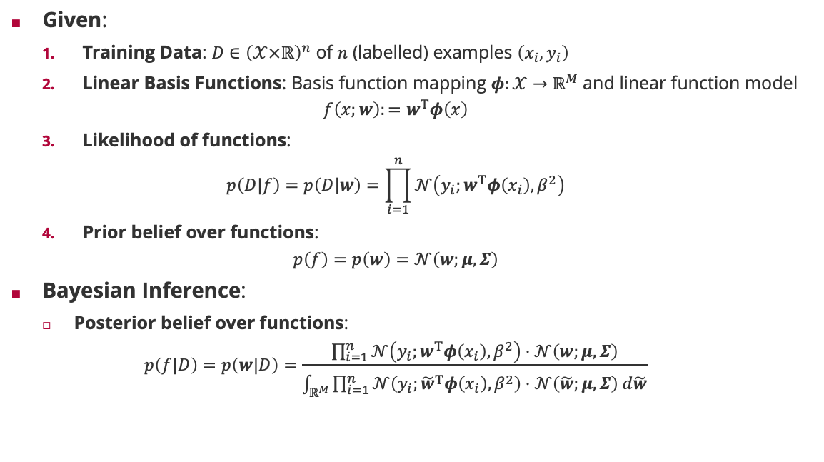



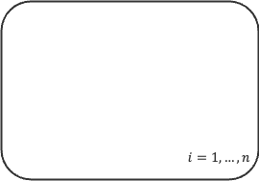


Bayesian Inference of Linear Basis Function Models
Given:
Training Data: $D∈{\left(𝒳×ℝ\right)}^{n}$ of $n$ (labelled) examples $\left(x_{i},y_{i}\right)$
Linear Basis Functions: Basis function mapping $φ:𝒳→ℝ^{M}$ and linear function model
$$f\left(x;w\right):=w^{T}φ\left(x\right)$$
Likelihood of functions:
$$p\left(D|f\right)=p\left(D | w\right)=\prod_{i=1}^{n}{𝒩\left(y_{i};w^{T}φ\left(x_{i}\right),β^{2}\right)}$$
Prior belief over functions:
$$p\left(f\right)=p\left(w\right)=𝒩\left(w;μ,Σ\right)$$
Bayesian Inference:
Posterior belief over functions:
$$p\left(f|D\right)=p\left(w|D\right)=\frac{\prod_{i=1}^{n}{𝒩\left(y_{i};w^{T}φ\left(x_{i}\right),β^{2}\right)}⋅𝒩\left(w;μ,Σ\right)}{\int_{ℝ^{M}}{\prod_{i=1}^{n}{𝒩\left(y_{i};{\tilde{w}}^{T}φ\left(x_{i}\right),β^{2}\right)}⋅𝒩\left(\tilde{w};μ,Σ\right) d\tilde{w}}}$$
Factor Graph
$$𝒩\left(w;μ,Σ\right)$$
$$w$$
feature vector
$$i=1,…,n$$
weight vector
Bayesian Network
$$δ\left(t_{i}−w^{T}φ\left(x_{i}\right) \right)$$
$$w$$
$$t_{i}$$
$$i=1,…,n$$
$x_{i}$
$$y_{i}$$
$$𝒩\left(t_{i};y_{i },β^{2} \right)$$

Slide 5
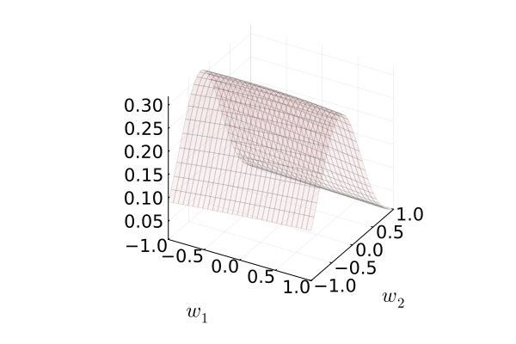
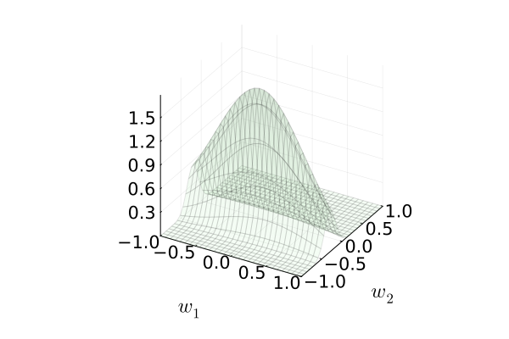
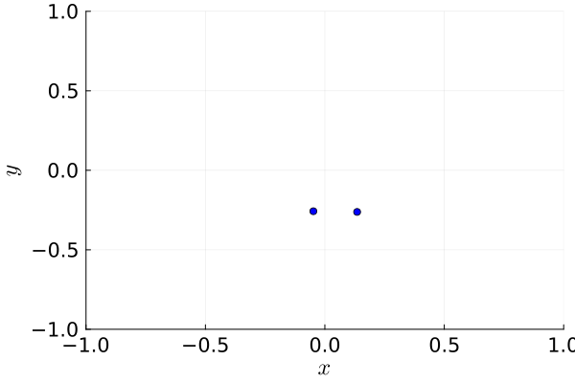
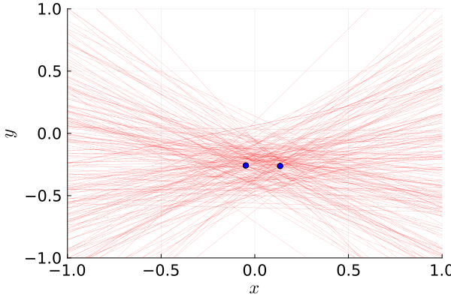
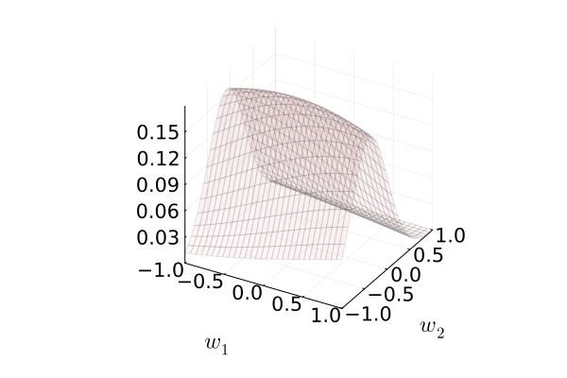
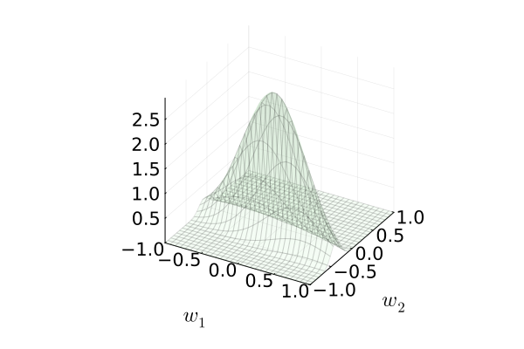
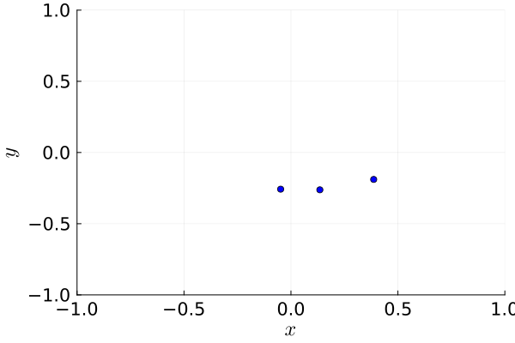
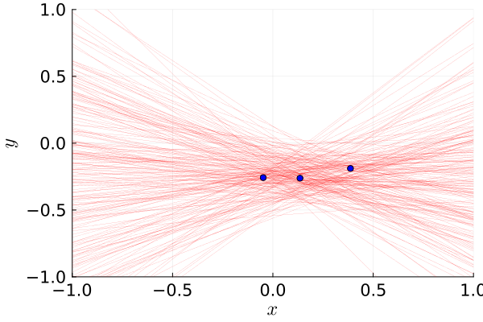
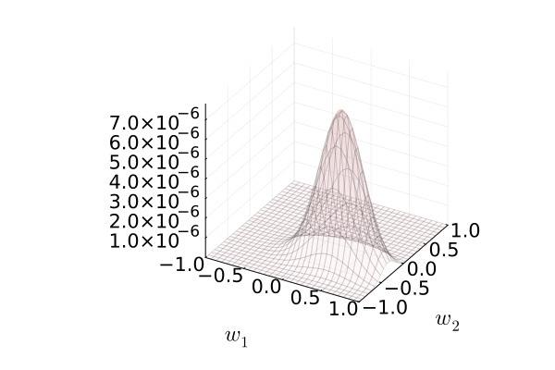
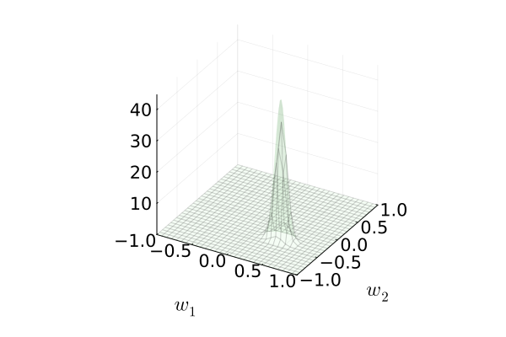
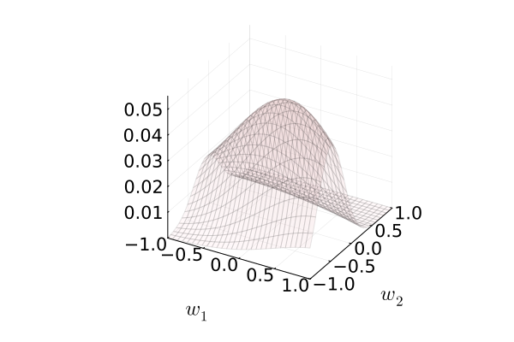
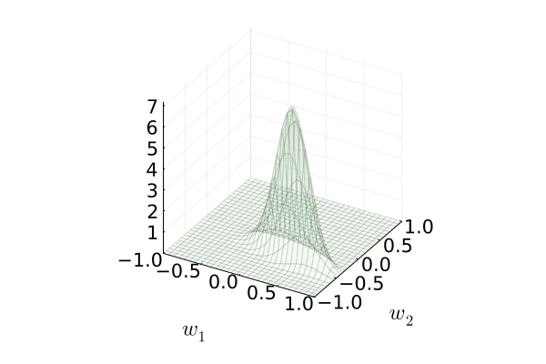
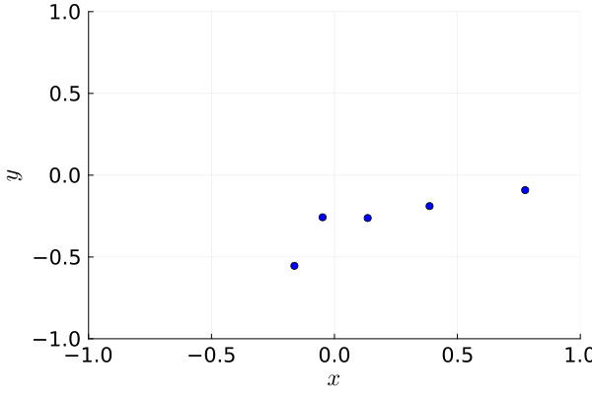
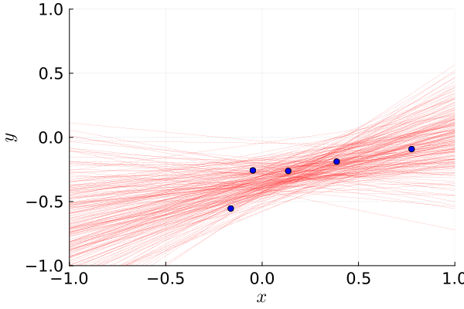
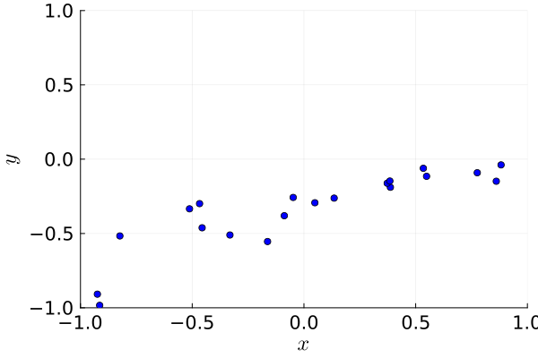
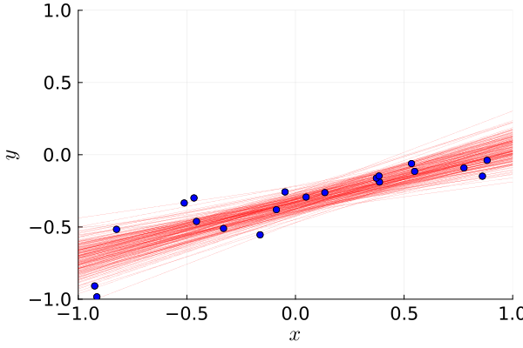







Bayesian Inference in Pictures
Likelihood
Posterior
Input Space
$$n=2$$
$$f\left(x\right)=w_{1}x+w_{2}$$
$$P\left(y|x\right)=𝒩\left(y;f\left(x\right),{0.2}^{2} \right)$$
$$P\left(w_{j}\right)=𝒩\left(w_{j};0,0.5\right)$$
$$n=3$$
$$n=5$$
$$n=20$$

Slide 6
Overview
Bayesian Linear Regression
Bayesian Linear Regression via Message Passing
Normal Distribution Revisited
Posterior and Predictive Distribution
Fast Bayesian Linear Regression
Bayesian Linear Regression via Linear Algebra

Slide 7
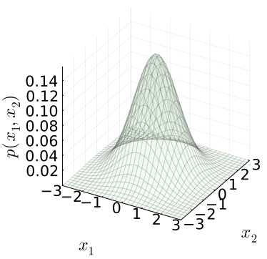
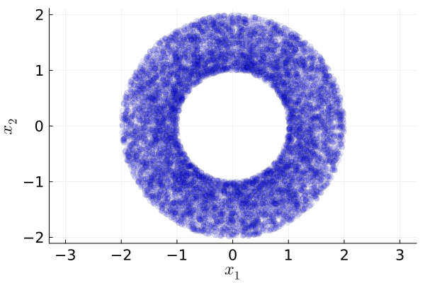
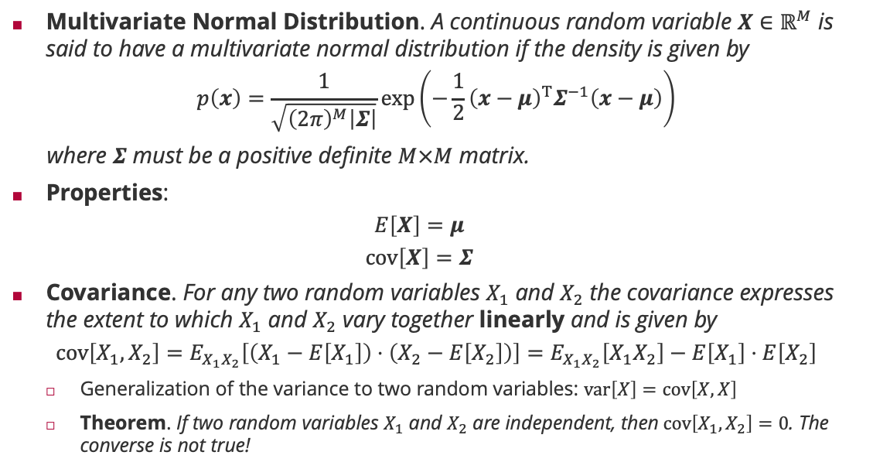
Multivariate Normal Distribution
Multivariate Normal Distribution. A continuous random variable $X∈ℝ^{M}$ is said to have a multivariate normal distribution if the density is given by
$$p\left(x\right)=\frac{1}{\sqrt{{\left(2π\right)}^{M}\left|Σ\right|}}\exp\left(−\frac{1}{2}{\left(x−μ\right)}^{T}Σ^{−1}\left(x−μ\right)\right)$$
where $Σ$ must be a positive definite $M×M$ matrix.
Properties:
$$E\left[X\right]=μ$$
$$cov\left[X\right]=Σ$$
Covariance. For any two random variables $X_{1}$ and $X_{2}$ the covariance expresses the extent to which $X_{1}$ and $X_{2}$ vary together linearly and is given by
$$cov\left[X_{1},X_{2}\right]=E_{X_{1}X_{2}}\left[\left(X_{1}−E\left[X_{1}\right]\right)⋅\left(X_{2}−E\left[X_{2}\right]\right)\right]=E_{X_{1}X_{2}}\left[X_{1}X_{2}\right]−E\left[X_{1}\right]⋅E\left[X_{2}\right]$$
Generalization of the variance to two random variables: $var\left[X\right]=cov\left[X,X\right]$
Theorem. If two random variables $X_{1}$ and $X_{2}$ are independent, then$cov\left[X_{1},X_{2}\right]=0$. The converse is not true!

Slide 8
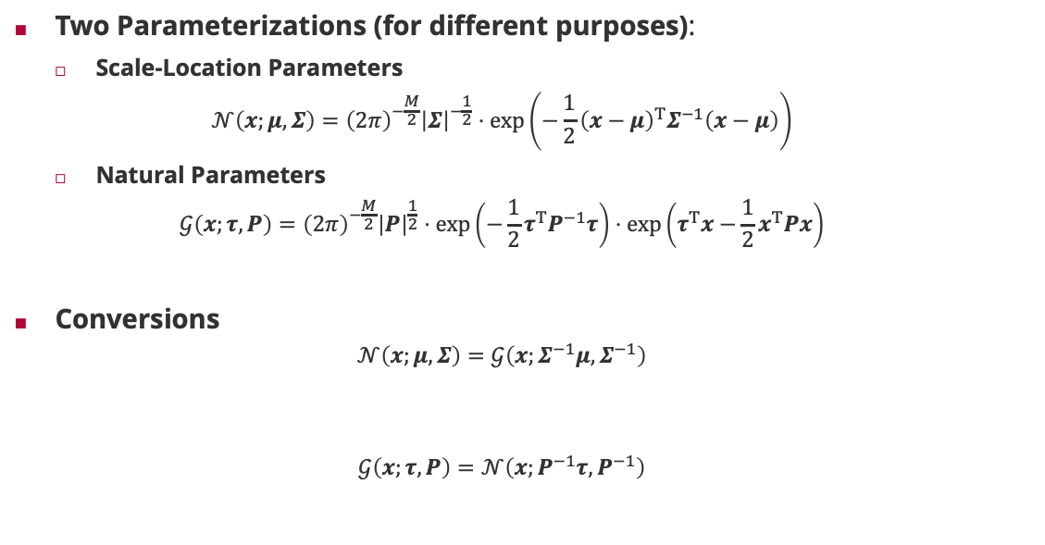
Multivariate Normal Distribution: Representations
Two Parameterizations (for different purposes):
Scale-Location Parameters
$$𝒩\left(x;μ,Σ\right)={\left(2π\right)}^{−\frac{M}{2}}{\left|Σ\right|}^{−\frac{1}{2}}⋅\exp\left(−\frac{1}{2}{\left(x−μ\right)}^{T}Σ^{−1}\left(x−μ\right)\right)$$
Natural Parameters
$$𝒢\left(x;τ,P\right)={\left(2π\right)}^{−\frac{M}{2}}{\left|P\right|}^{\frac{1}{2}}⋅\exp\left(−\frac{1}{2}τ^{T}P^{−1}τ\right)⋅\exp\left(τ^{T}x−\frac{1}{2}x^{T}Px\right)$$
Conversions
$$𝒩\left(x;μ,Σ\right)=𝒢\left(x;Σ^{−1}μ,Σ^{−1}\right)$$
$$𝒢\left(x;τ,P\right)=𝒩\left(x;P^{−1}τ,P^{−1}\right)$$
Matrix inverse

Slide 9
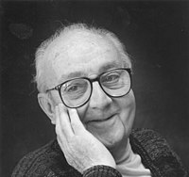

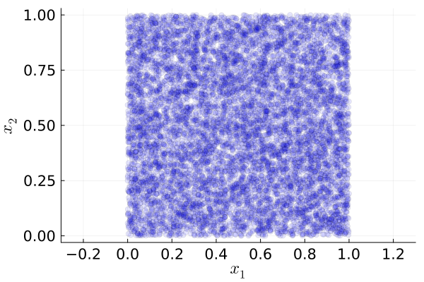
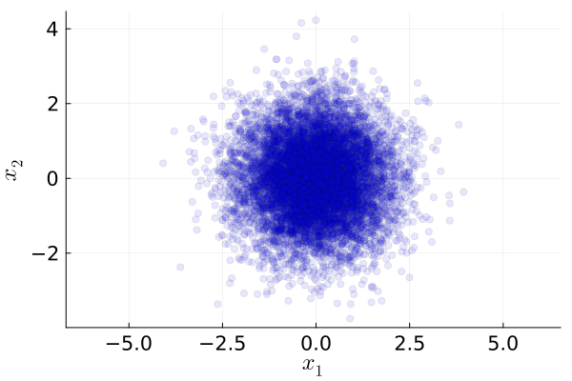
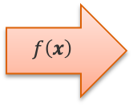
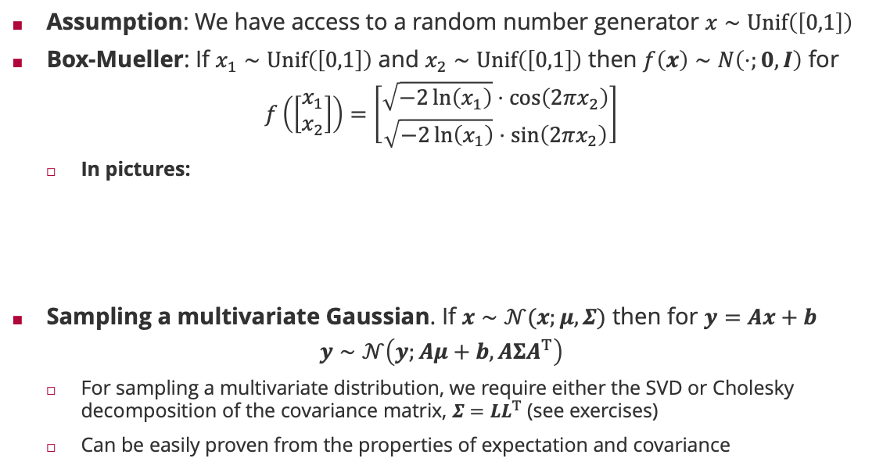
Sampling Multivariate Normal Distribution
Assumption: We have access to a random number generator $x∼Unif\left(\left[0,1\right]\right)$
Box-Mueller: If $x_{1}∼Unif\left(\left[0,1\right]\right)$ and $x_{2}∼Unif\left(\left[0,1\right]\right)$ then $f\left(x\right)∼N\left(⋅;0,I\right)$ for
$$f\left(\left[\begin{matrix}x_{1} \\ x_{2}\end{matrix}\right]\right)=\left[\begin{matrix}\sqrt{−2\ln\left(x_{1}\right)}⋅\cos\left(2πx_{2}\right) \\ \sqrt{−2\ln\left(x_{1}\right)}⋅\sin\left(2πx_{2}\right)\end{matrix}\right]$$
In pictures:
Sampling a multivariate Gaussian. If $x∼𝒩(x;μ,Σ)$ then for $y=Ax+b$
$$y∼𝒩\left(y;Aμ+b,AΣA^{T}\right)$$
For sampling a multivariate distribution, we require either the SVD or Cholesky decomposition of the covariance matrix, $Σ=LL^{T}$ (see exercises)
Can be easily proven from the properties of expectation and covariance
George Box (1919 – 2013)
$$f\left(x\right)$$
Mervin Mueller (1928 – 2018)

Slide 10
Overview
Bayesian Linear Regression
Bayesian Linear Regression via Message Passing
Normal Distribution Revisited
Posterior and Predictive Distribution
Fast Bayesian Linear Regression
Bayesian Linear Regression via Linear Algebra

Slide 11

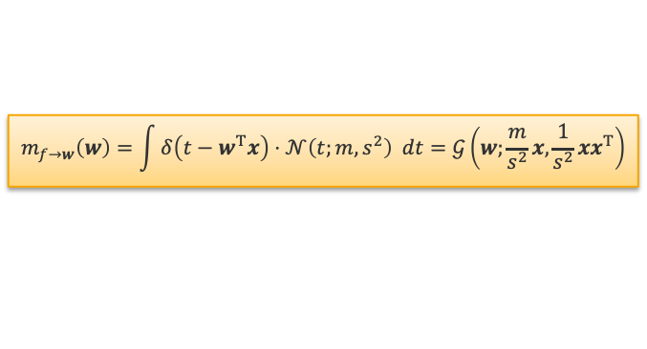



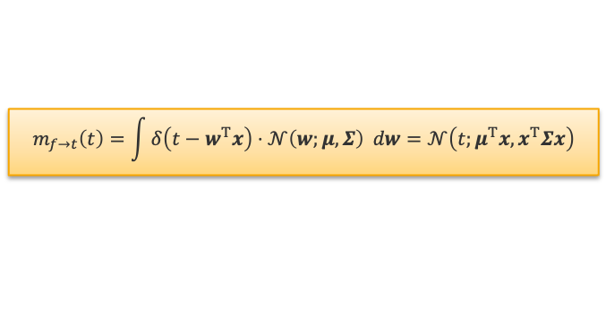
















Multivariate Message Update Equations
Gaussian Factor
Gaussian Projection Factor
Factor Graph
$$m_{f→w}\left(w\right)$$
$$𝒩\left(w;μ,Σ \right)$$
$$m_{f→t}\left(t\right)$$
$$𝒩\left(w;μ,Σ\right)$$
$$𝒩\left(w;μ,Σ\right)$$
$$w$$
$$w$$
$$t$$
$$δ\left({t−w}^{T}x\right)$$
$$w$$
$$m_{f→w}\left(w\right)=𝒩\left(w;μ,Σ\right)$$
$$m_{f→t}\left(t\right)=\int{δ\left(t−w^{T}x\right)⋅𝒩\left(w;μ,Σ\right) dw}=𝒩\left(t;μ^{T}x,x^{T}Σx\right)$$
$$i=1,…,n$$
$$δ\left(t_{i}−w^{T}φ\left(x_{i}\right) \right)$$
$$t_{i}$$
$$𝒩\left(t_{i};y_{i }β^{2} \right)$$
$$m_{f→w}\left(w\right)$$
$$𝒩\left(t;m,s^{2} \right)$$
$$w$$
$$t$$
$$δ\left({t−w}^{T}x\right)$$
$$m_{f→w}\left(w\right)=\int{δ\left(t−w^{T}x\right)⋅𝒩\left(t;m,s^{2}\right) dt}=𝒢\left(w;\frac{m}{s^{2}}x,\frac{1}{s^{2}}xx^{T}\right)$$

Slide 12


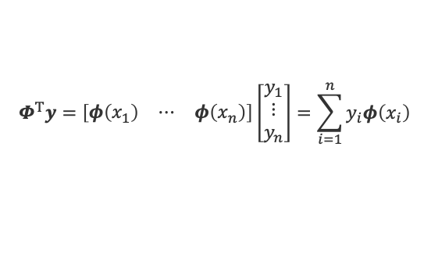






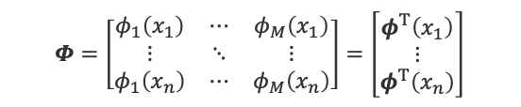





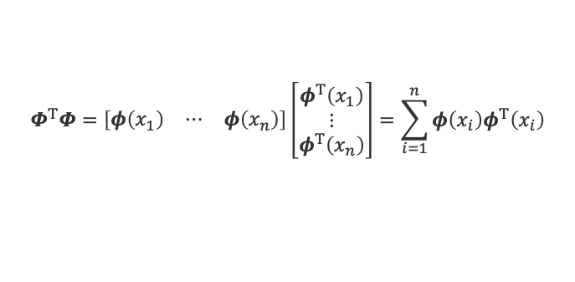



Bayesian Linear Regression by Message Passing
$$𝒩\left(w;μ,Σ\right)$$
Message: Simple factor tree where each training example is summarized in an $M$-dimensional message
Prior Message $m_{1,0}\left(w\right)=𝒢\left(w;Σ^{−1}μ,Σ^{−1}\right)=p\left(w\right)$
Target Message $m_{2,i}\left(t_{i}\right)=𝒩\left(t_{i};y_{i},β^{2}\right)=p\left(y_{i}|t_{i}\right)$
Data Message $m_{1,i}\left(w\right)=𝒢\left(w;β^{−2}y_{i}φ\left(x_{i}\right),β^{−2}φ\left(x_{i}\right)φ^{T} \left(x_{i}\right)\right)=p\left(y_{i}|w\right)$
Posterior: Multiplying prior and data messages we have
$$p\left(w|D\right)=𝒢\left(w;Σ^{−1}μ+β^{−2}\sum_{i=1}^{n}{y_{i}φ\left(x_{i}\right)},Σ^{−1}+β^{−2}\sum_{i=1}^{n}{φ\left(x_{i}\right)φ^{T} \left(x_{i}\right)}\right)$$
Feature Matrix: All feature vectors are stacked on top of each other in a feature matrix
$$m_{1,0}\left(w\right)$$
$$m_{1,1}\left(w\right)$$
$$w$$
$$m_{1,n}\left(w\right)$$
$$δ\left(t_{1}−w^{T}φ\left(x_{1}\right)\right)$$
$$δ\left(t_{n}−w^{T}φ\left(x_{n}\right)\right)$$
$$m_{2,1}\left(t_{1}\right)$$
$$m_{2,n}\left(t_{n}\right)$$
$$t_{1}$$
$$t_{n}$$
$$m_{2,1}\left(t_{1}\right)$$
$$m_{2,n}\left(t_{n}\right)$$
$$𝒩\left(t_{1};y_{1},β^{2}\right)$$
$$𝒩\left(t_{n};y_{n},β^{2}\right)$$
feature vector
$$Φ=\left[\begin{matrix}φ_{1}\left(x_{1}\right) & ⋯ & φ_{M}\left(x_{1}\right) \\ ⋮ & ⋱ & ⋮ \\ φ_{1}\left(x_{n}\right) & ⋯ & φ_{M}\left(x_{n}\right)\end{matrix}\right]=\left[\begin{matrix}φ^{T}\left(x_{1}\right) \\ ⋮ \\ φ^{T}\left(x_{n}\right)\end{matrix}\right]$$
$$Φ^{T}y=\left[\begin{matrix}φ\left(x_{1}\right) & ⋯ & φ\left(x_{n}\right)\end{matrix}\right]\left[\begin{matrix}y_{1} \\ ⋮ \\ y_{n}\end{matrix}\right]=\sum_{i=1}^{n}{y_{i}φ\left(x_{i}\right)}$$
$$Φ^{T}Φ=\left[\begin{matrix}φ\left(x_{1}\right) & ⋯ & φ\left(x_{n}\right)\end{matrix}\right]\left[\begin{matrix}φ^{T}\left(x_{1}\right) \\ ⋮ \\ φ^{T}\left(x_{n}\right)\end{matrix}\right]=\sum_{i=1}^{n}{φ\left(x_{i}\right)φ^{T}\left(x_{i}\right)}$$

Slide 13









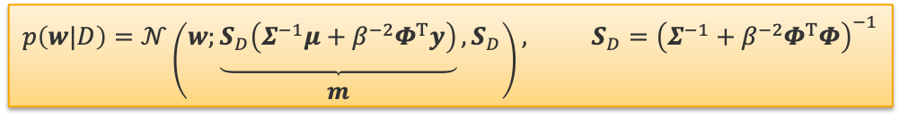




Predictions
Predicition Tree: Simple factor chain given posterior $p\left(w|x,D\right)=𝒩\left(w;μ,Σ\right)$
Posterior Message $m_{1}\left(w\right)=𝒩\left(w;μ,Σ\right)=p\left(w|x,D\right)$
Projection Message $m_{2}\left(t\right)=𝒩\left(t;μ^{T}φ\left(x\right),φ^{T}\left(x\right)Σφ\left(x\right)\right)=p\left(t|x,D\right)$
Prediction Message $m_{3}\left(y\right)=𝒩\left(y;μ^{T}φ\left(x\right),β^{2}+φ^{T}\left(x\right)Σφ\left(x\right)\right)=p\left(y|x,D\right)$
Bayesian Linear Regression in Matrix Notation
$$𝒩\left(w;μ,Σ\right)$$
$$m_{1}\left(w\right)$$
$$w$$
$$m_{1}\left(w\right)$$
$$δ\left(t−w^{T}φ\left(x\right)\right)$$
$$m_{2}\left(t\right)$$
$$t$$
$$m_{2}\left(t\right)$$
$$p\left(w|D\right)=𝒩\left(w;\underset{\begin{aligned} \\ m\end{aligned}}{\underbrace{S_{D}\left(Σ^{−1}μ+β^{−2}Φ^{T}y\right)}},S_{D}\right), S_{D}={\left(Σ^{−1}+β^{−2}Φ^{T}Φ\right)}^{−1}$$
$$𝒩\left(y;t,β^{2}\right)$$
$$m_{3}\left(y\right)$$
$$y$$
$$p\left(y|x,D\right)=𝒩\left(y;m^{T}φ\left(x\right),β^{2}+φ^{T}\left(x\right)S_{D}φ\left(x\right) \right)$$
data uncertainty
model uncertainty

Slide 14




Bayesian Linear Regression: Example
$$p\left(w\right)=𝒩\left(w;0,λ^{2}I\right)$$
$$λ=10$$
$$λ=1$$
Gaussian Basis
$$φ_{j}\left(x\right)=𝒩\left(x;j,{0.15}^{2}\right)$$
Polynomial Basis
$$φ_{j}\left(x\right)=x^{j}$$

Slide 15
Overview
Bayesian Linear Regression
Bayesian Linear Regression via Message Passing
Normal Distribution Revisited
Posterior and Predictive Distribution
Fast Bayesian Linear Regression
Bayesian Linear Regression via Linear Algebra

Slide 16





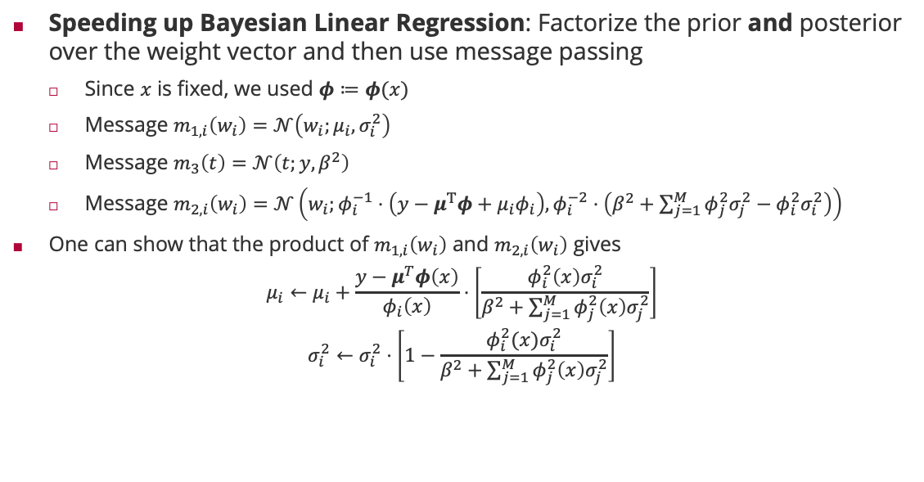








Fast Bayesian Linear Regression
$$𝒩\left(w_{1};μ_{1},σ_{1}^{2}\right)$$
$$𝒩\left(w_{M};μ_{M},σ_{M}^{2}\right)$$
Speeding up Bayesian Linear Regression: Factorize the prior and posterior over the weight vector and then use message passing
Since $x$ is fixed, we used $φ≔φ(x)$
Message $m_{1,i}\left(w_{i}\right)=𝒩\left(w_{i};μ_{i},σ_{i}^{2}\right)$
Message $m_{3}\left(t\right)=𝒩\left(t;y,β^{2}\right)$
Message $m_{2,i}\left(w_{i}\right)=𝒩\left(w_{i};φ_{i}^{−1}⋅\left(y−μ^{T}φ+μ_{i}φ_{i}\right),φ_{i}^{−2}⋅\left(β^{2}+\sum_{j=1}^{M}{φ_{j}^{2}σ_{j}^{2}}−φ_{i}^{2}σ_{i }^{2}\right)\right)$
One can show that the product of $m_{1,i}\left(w_{i}\right)$ and $m_{2,i}\left(w_{i}\right)$ gives
$$μ_{i}←μ_{i}+\frac{y−μ^{T}φ\left(x\right)}{φ_{i}\left(x\right)}⋅\left[\frac{φ_{i }^{2}\left(x\right)σ_{i}^{2}}{β^{2}+\sum_{j=1}^{M}{φ_{j}^{2}\left(x\right)σ_{j}^{2}}}\right]$$
$$σ_{i}^{2}←σ_{i}^{2}⋅\left[1−\frac{φ_{i }^{2}(x)σ_{i}^{2}}{β^{2}+\sum_{j=1}^{M}{φ_{j}^{2}\left(x\right)σ_{j}^{2}}}\right]$$
$$m_{1,1}\left(w_{1}\right)$$
$$m_{1,M}\left(w_{M}\right)$$
$$w_{1}$$
$$m_{2,i}\left(w_{i}\right)$$
$$w_{M}$$
$$δ\left(t−w^{T}φ\left(x\right)\right)$$
$$m_{3}\left(t\right)$$
$$t$$
$$m_{3}\left(t\right)$$
$$𝒩\left(t;y,β^{2}\right)$$
target mismatch is measured in units of $φ_{i}\left(x\right)$
largest for parameter with largest uncertainty so far
multiplicative update

Slide 17
Speeding up Bayesian Linear Regression
Nearly orthogonal features
Weakly correlated features
Strongly correlated features

Slide 18
Overview
Bayesian Linear Regression
Bayesian Linear Regression via Message Passing
Normal Distribution Revisited
Posterior and Predictive Distribution
Fast Bayesian Linear Regression
Bayesian Linear Regression via Linear Algebra

Slide 19
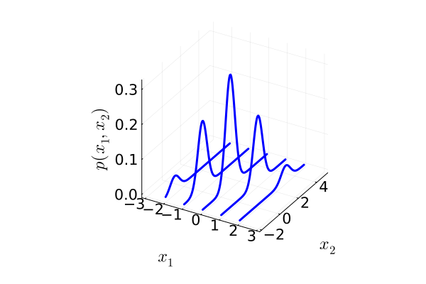
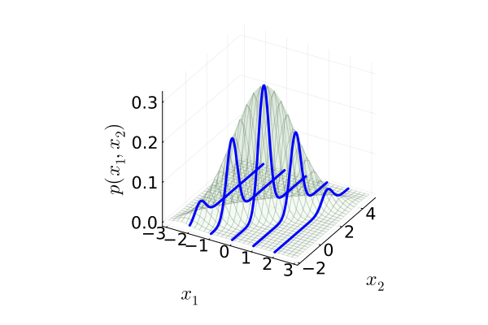
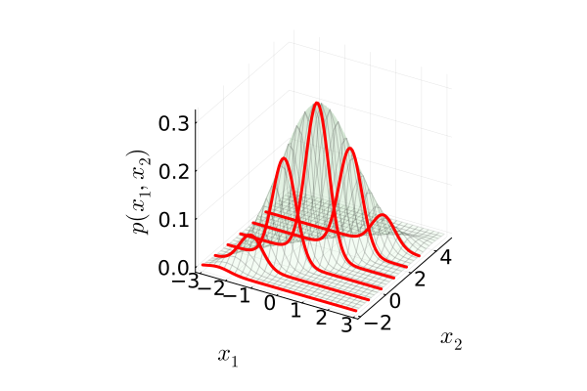




Bayes’ Theorem for Normal Distributions
Conjugate Gaussians. Given a normally distributed variable
$$x∼𝒩\left(x;μ,Σ\right)$$
and a conditional distribution for $y$ given $x$ such that $y|x∼𝒩\left(y;Ax+b,S\right)$ we have the following for the marginal $p\left(y\right)$ and the “inverse” conditional $p\left(x|y\right)$
$p\left(y\right)=𝒩\left(y;Aμ+b,S+AΣA^{T} \right)$
$$p\left(x|y\right)=𝒢\left(x;Σ^{−1}μ+A^{T}S^{−1}\left(y−b\right),Σ^{−1}+A^{T}S^{−1}A\right),$$
$p\left(x_{1}\right)=$ $𝒩\left(x_{1};0,1\right)$
$$p\left(x_{2} | x_{1}\right)=𝒩\left(x_{2};x_{1}+1,\frac{1}{2}\right)$$
$$p\left(x_{1}|x_{2}\right)=𝒩\left(x_{1};\frac{2}{3}\left(x_{2}−1\right),\frac{1}{3} \right)$$

Slide 20
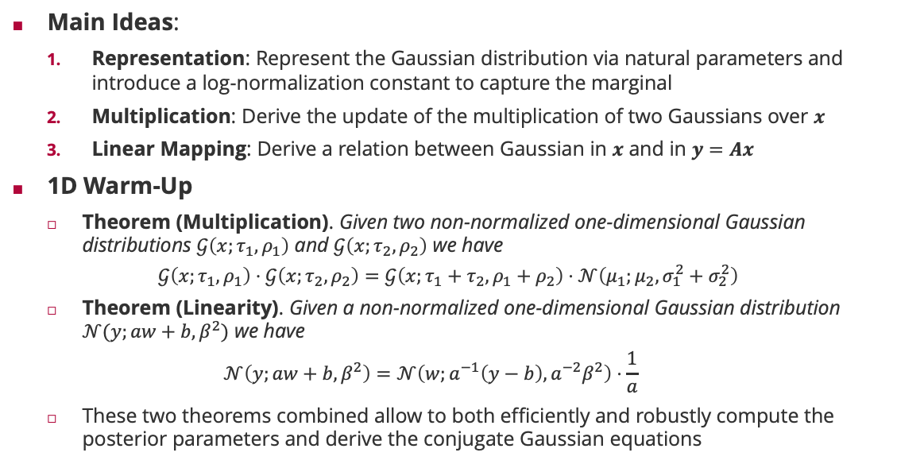
Conjugate Gaussians: Derivation
Main Ideas:
Representation: Represent the Gaussian distribution via natural parameters and introduce a log-normalization constant to capture the marginal
Multiplication: Derive the update of the multiplication of two Gaussians over $x$
Linear Mapping: Derive a relation between Gaussian in $x$ and in $y=Ax$
1D Warm-Up
Theorem (Multiplication). Given two non-normalized one-dimensional Gaussian distributions $𝒢\left(x;τ_{1},ρ_{1}\right)$ and $𝒢\left(x;τ_{2},ρ_{2}\right)$ we have
$$𝒢\left(x;τ_{1},ρ_{1}\right)⋅𝒢\left(x;τ_{2},ρ_{2}\right)=𝒢\left(x;τ_{1}+τ_{2},ρ_{1}+ρ_{2}\right)⋅𝒩\left(μ_{1};μ_{2},σ_{1}^{2}+σ_{2}^{2}\right)$$
Theorem (Linearity). Given a non-normalized one-dimensional Gaussian distribution $𝒩(y;aw+b,β^{2})$ we have
$$𝒩\left(y;aw+b, β^{2}\right)=𝒩\left(w;a^{−1}\left(y−b\right), a^{−2}β^{2}\right)⋅\frac{1}{a}$$
These two theorems combined allow to both efficiently and robustly compute the posterior parameters and derive the conjugate Gaussian equations

Slide 21

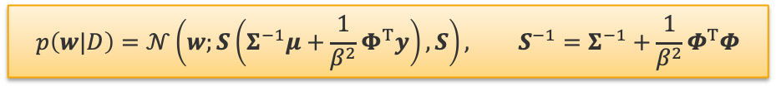

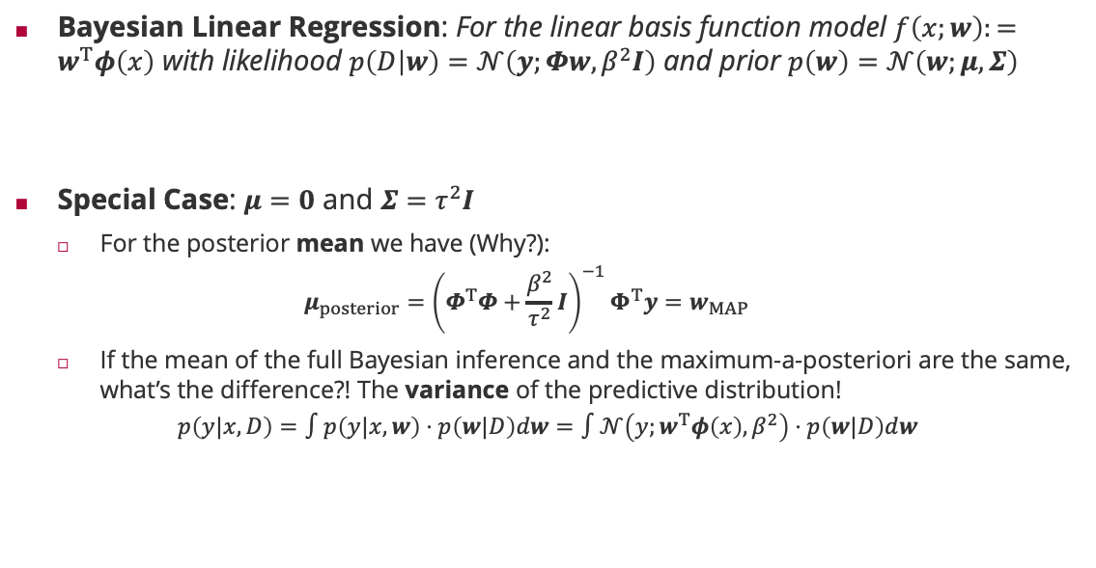



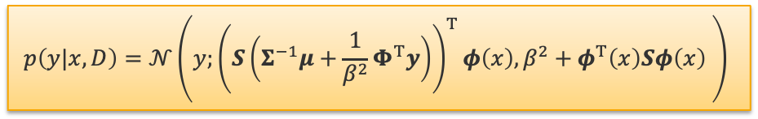

Bayesian Linear Regression
Bayesian Linear Regression: For the linear basis function model $f\left(x;w\right):=w^{T}φ\left(x\right)$ with likelihood $p\left(D | w\right)=𝒩\left(y;Φw,β^{2}I\right)$ and prior $p\left(w\right)=𝒩\left(w;μ,Σ\right)$
Special Case: $μ=0$ and $Σ=τ^{2}I$
For the posterior mean we have (Why?):
$$μ_{posterior}={\left(Φ^{T}Φ+\frac{β^{2}}{τ^{2}}I\right)}^{−1}Φ^{T}y=w_{MAP}$$
If the mean of the full Bayesian inference and the maximum-a-posteriori are the same, what’s the difference?! The variance of the predictive distribution!
$$p\left(y|x,D\right)=∫p\left(y|x,w\right)⋅p\left(w|D\right)dw=∫𝒩\left(y;w^{T}φ\left(x\right),β^{2}\right)⋅p\left(w|D\right)dw$$
Properties of Gaussians
$$p\left(w|D\right)=𝒩\left(w;S\left(Σ^{−1}μ+\frac{1}{β^{2}}Φ^{T}y\right),S\right), S^{−1}=Σ^{−1}+\frac{1}{β^{2}}Φ^{T}Φ$$
$$p\left(w\right)=𝒩\left(w;μ,Σ\right)$$
$$p\left(v|w\right)=𝒩\left(v;Aw,Ξ\right)$$
$$p\left(v\right)=𝒩\left(v;Aμ,Ξ+AΣA^{T} \right)$$
$$p\left(w|v\right)=𝒩\left(w;m,S\right)$$
$$m=S \left(A^{T}Ξ^{−1}v+Σ^{−1}μ\right)$$
$$S^{−1}=Σ^{−1}+A^{T}Ξ^{−1}A$$
$$p\left(y|x,D\right)=𝒩\left(y;{\left(S\left(Σ^{−1}μ+\frac{1}{β^{2}}Φ^{T}y\right)\right)}^{T}φ\left(x\right),β^{2}+φ^{T}\left(x\right)Sφ\left(x\right) \right)$$

Slide 22
Summary
Bayesian Linear Regression
Averaging over all functions weighting them by their posterior probability gives both a smoother mean and confidence intervals for each prediction (predictive distribution)
Marginals and conditionals for multivariate Normals are linearly transformed Normals!
Message passing on the Bayesian Regression factor graph involves no loops and is exact
For linear basis function models with Normal noise, the posterior can be computed closed form
Mean of Bayesian regression equals MAP solution but variance accounts for model uncertainty
Fast Bayesian Linear Regression
The Bayesian linear regression algorithm is of cubic complexity in the features and quadratic in the training set size
By factorizing both the prior and posterior distribution over the weight vector, we get a completely linear-complexity algorithm!

Slide 23
See you next week!

